Slide 1
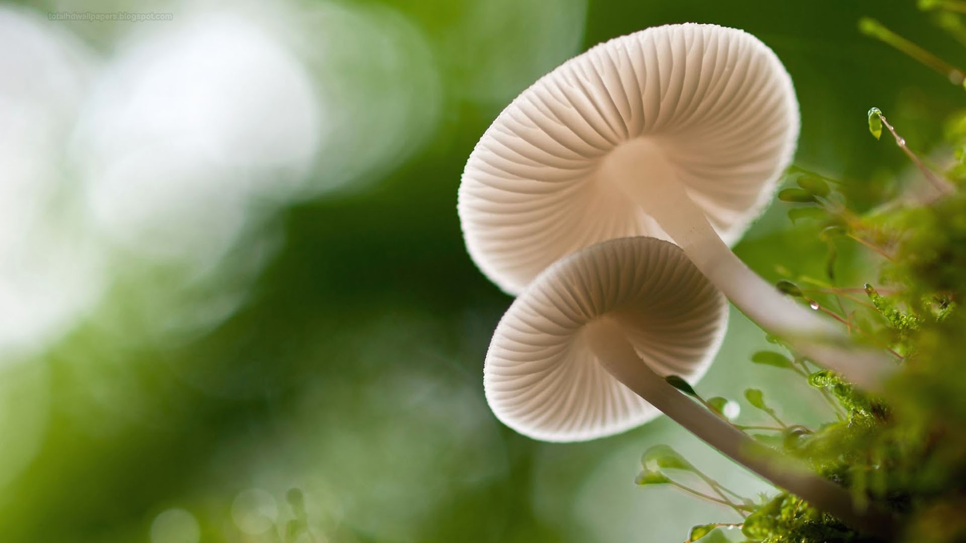
Mushroom Classification Amulya Tamma
Notes:
Hi, my name is Amulya Tamma and this is my data analytics term project, focused around mushroom classification.

Slide 2

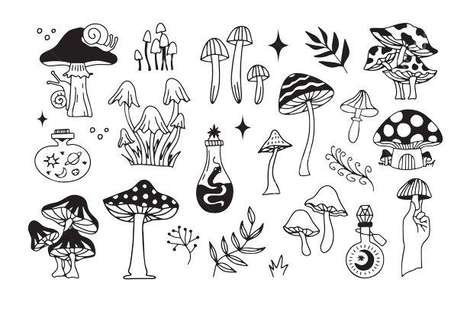
Abstract
The purpose of this project is to understand the relationships between the different characteristics of mushrooms and see if those attributes can be used to create a model that can guess the edibility of a mushroom with high accuracy.
The learning model is classification; the data is labeled (edible or poisonous) and several attributes are provided. This will be used to train a classification model that can predict the edibility of new mushrooms based on their attributes.
The algorithms that were focused on in this study are Logistic Regression and Support Vector Machines.
Notes:
The purpose of this project is to understand the relationships between the different characteristics of mushrooms and see if those attributes can be used to create a model that can guess whether or not a mushroom is edible or poisonous with high accuracy.
The learning model used here is classification, where the algorithm learns from labeled data to predict the category or class of new observations. Here, the labeled output variable is categorical (edible vs poisonous) and will be used to train a classification model that can predict this target class from several different attributes.
The algorithms focused on in this study are Logistic Regression and Support Vector Machines (using different kernels). The accuracy is calculated for all of these algorithms and then compared with each other to find the best model.

Slide 3
Attributes
Class [Target]: Indicates mushroom edibility [p = poisonous, e = edibility]
Diameter of Mushroom Cap [cm]
Cap Shape: b = bell, c = conical, x = convex, f = flat, s = sunken, p = spherical, o =others
Cap Surface: Texture of the mushroom cap surface, i = fibrous, g = grooves, y = scaly, s = smooth, h = shiny, l = leathery, etc.
Cap Color
Does Bruise or Bleed: Indicates if the mushroom bruises or bleeds when injured [true or false]
Gill Attributes: Gill Attachment, Gill Spacing, Gill Color
Stem Attributes: Stem Width, Stem Root, Stem Surface, Stem Color
Veil Attributes: Veil Color, Veil Type
Ring Attributes: Has Ring, Ring Type
Spore Print Color
Habitat
Season
Notes:
Here are the characteristics or features that are included in this dataset. The class is our target variable, where p indicates poisonous and e indicates edible. Other features that were used include diameter of the mushroom cap, cap shape, cap surface, cap color, if the mushroom bruises or bleeds when it gets injured, and then more specific attributes about different parts of the mushroom. This includes different attributes about the gills, the stem, the veil, and the ring, as well as the spore print color. Finally, the habitat and season the mushrooms were found in were also considered.
There are 20 attributes in total, with three numerical features: cap diameter, stem height, and stem width. The rest of the features are categorical.

Slide 4
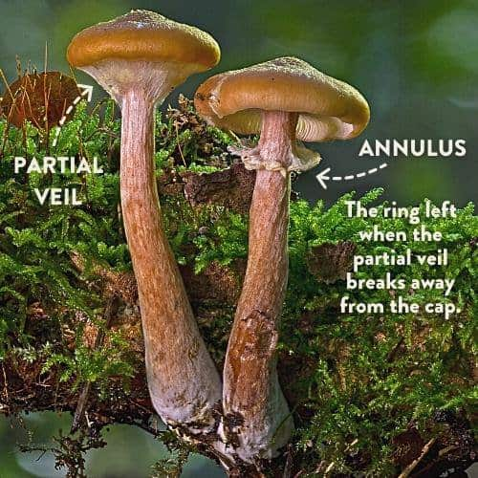
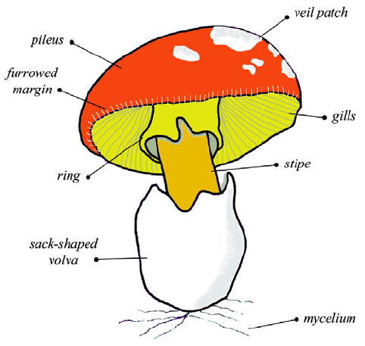
Notes:
These images were included to greater understand the attributes of mushrooms; parts of the dataset included attributes about the gills, the ring, the veil, and the cap. Considering I didn’t really know anything about mushrooms before doing this study, it was good background information to have to better understand the dataset I was working with.

Slide 5
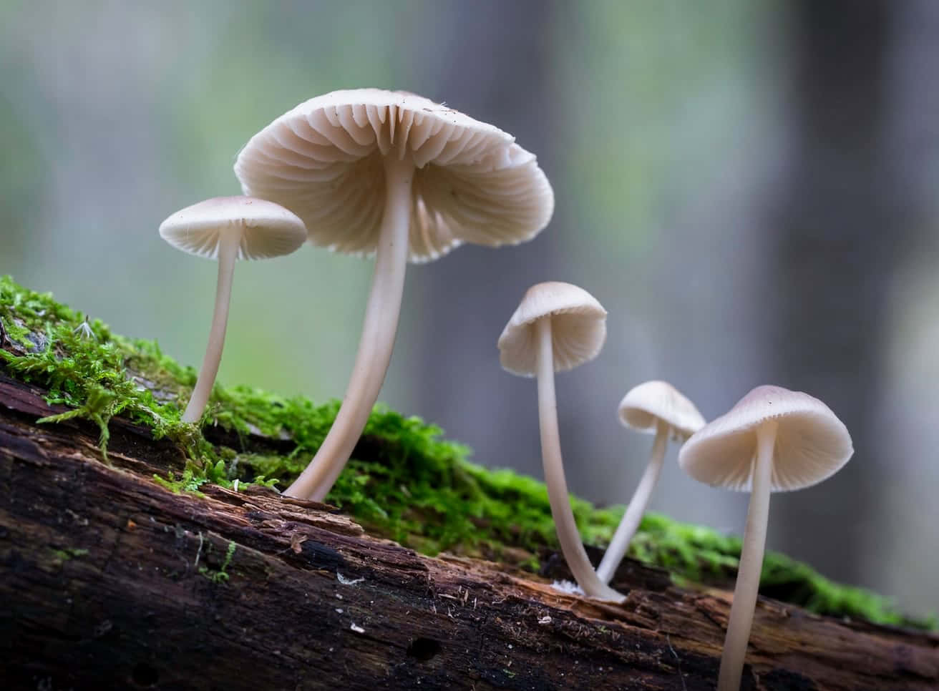
Data Exploration and Cleaning
Notes:
Given the massive dataset, there was a lot of filtering and cleaning necessary.

Slide 6
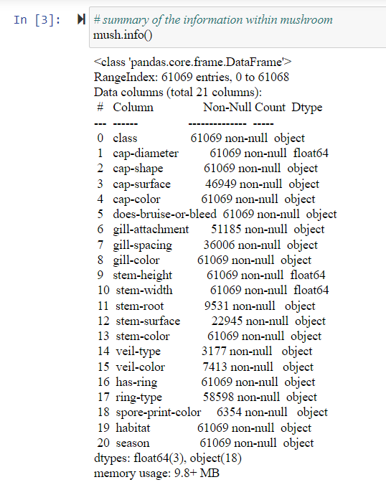
Dataset Information
Started with 61, 069 instances
All of the rows had NaN values
Sourced from Kaggle
Notes:
Just some basic things about the original dataset; it started out with 61k instances and every single row had an NaN value, which means that I couldn’t necessarily remove all of the rows with missing values because I essentially wouldn’t have a dataset remaining.
Considering there was a lot of instances, there was a lot of filtering that had to be done.

Slide 7

Dataset Filtering
Dropped duplicates
Dropped observations without the target variable
Removed observations that didn’t have Cap Surface (had the greatest amount of missing values)
Later subsetted by removing gill-spacing, gill-attachment, and stem-root
Narrowed down to 3883 rows
Notes:
In order to narrow the dataset down, duplicates and observations without the target variable were dropped. In addition to this, observations without cap surface were also dropped, because it had the greatest amount of missing values. In addition to this, the dataset was subsetted by removing gill spacing, gill attachment, and stem root in order to narrow down the dataset to an ideal amount. The final size was 3883 instances.

Slide 8
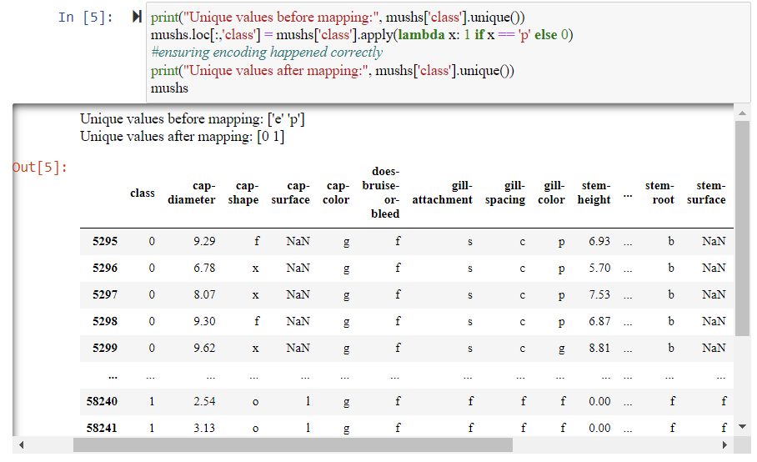
Encoding
Class column as a categorical variable, needed to be converted into numerical format
Used one-hot encoding to encode poisonous to 1 and edible represented as 0 [binary]
Notes:
Because the 'class' column is a categorical variable, this value must be converted into a numerical format that can be used for classification. In the mushroom dataset, many of the variables can be one-hot encoded to transform the categorial variables into binary vectors that represent the presence or absence of each category. For the class column specifically, one-hot encoding was used to encode poisonous to 1 and edible as 0.

Slide 9

Initial Modeling: Logistic Regression
Notes:
Because the class feature here only has two outcomes (edible versus poisonous), it is perfect to use logistic regression. The underlying assumption is that the mushroom observations are independent from each other and don’t depend on any other observations.

Slide 10
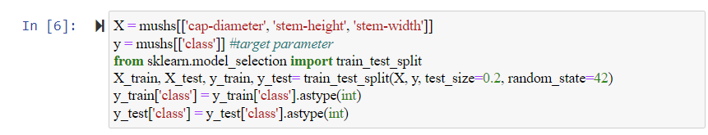
Preparing the Dataset
80% Training Data & 20% Test Data
Data is randomized within splitting to ensure random distribution.
Originally using solely quantitative, continuous variables [cap diameter, stem height, stem width]
Notes:
Originally, I just wanted to see what would happen if I solely used the quantitative variables, so the features for this dataset are cap diameter, stem height, and stem width. For every model in this study, the data was split into 80% training data and 20% test data.
In addition to this, the data is randomized within the splitting to ensure that the points are randomly distributed across the training and testing sets to reduce the risk of introducing bias or other patterns into the sets. I was hoping that this randomization also ensure that the model is more generalizable.

Slide 11
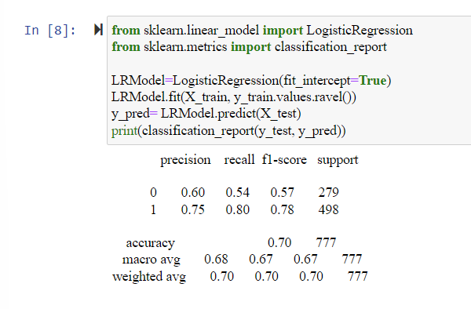

Logistic Regression Model
Okay results, with accuracy of 0.70
Fit_intercept= True to estimate bias & improve overall performance
Does better predicting poisonous mushrooms than edible mushrooms
Notes:
Creating the model and generating the classification report, we find that the precision, recall, and F1-score for class 1 are much greater than that for class 0, which means that model does much better for classifying poisonous mushrooms (class 1) than edible mushrooms. The 70% accuracy of the model suggests that the model performs okay.
While cap diameter, stem height, and stem width appear to be informative features for predicting the edibility of mushrooms, I wanted to consider the other categorical variables to make the model better.

Slide 12
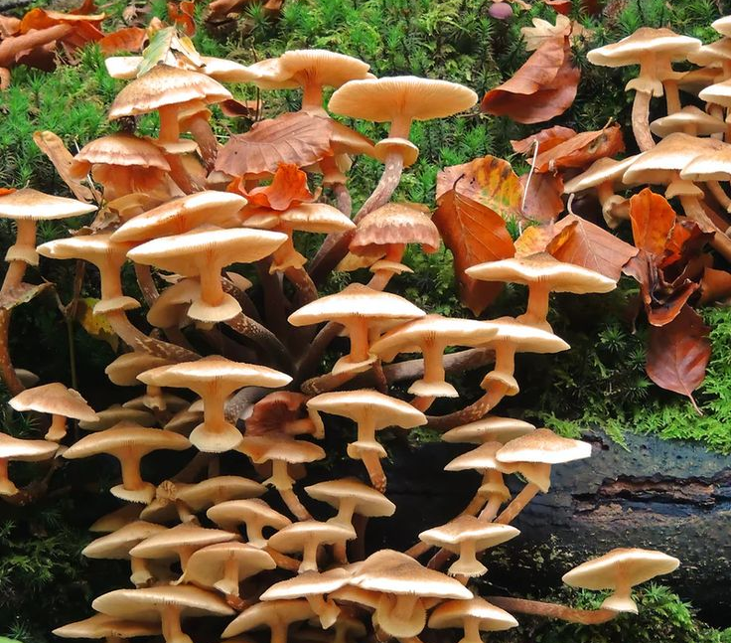
Logistic Regression: Expanded Modeling
Notes:
Using the rest of the features, including the rest of the categorical variables, I created a new, expanded model.

Slide 13
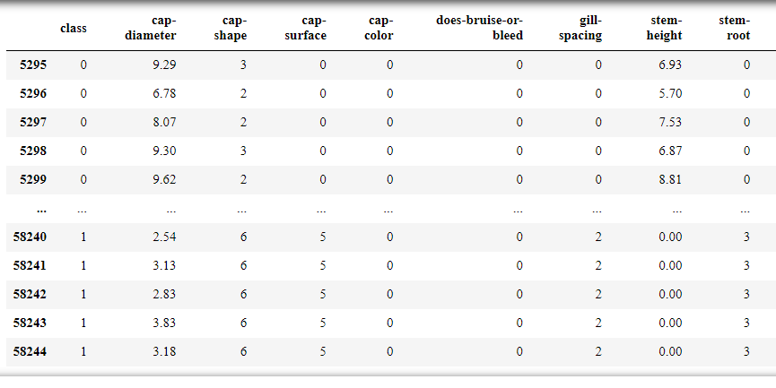
Imputation & Encoding of Categorical Variables
Using more features, but many NaN Values
Potential Effects:
Preservation of Data Integrity
Changes in Relationships
Assumption Violations
Overfitting
Mapping to Numerical
Notes:
All of the features that I wanted to use were categorical, and every single row was missing these values; in order to account for this, I had to imputate the dataset, or replace every missing value with the mode of its column in order to preserve the integrity of the dataset. This could have several different effects including, changing the relationships between variables, violating the random assumption, or could make the model more prone to overfitting, as it could introduce noise or other artificial patterns into the data. All of these were important to consider while doing subsequent analysis.
After imputating all of the missing values (with no remaining NaN values), all of the categorical features were mapped to numerical values.

Slide 14
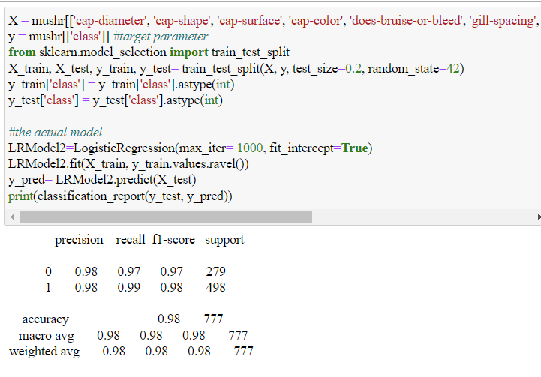

Logistic Regression
Goal: greater than 70% accuracy
98% accuracy
Imputation had less of an effect than I would have guessed
Notes:
Using all of the features together (both quantitative and categorical), I ended up creating a model as shown here. We can see that the model does significantly better, predicting 98% of all of the mushrooms in the dataset correctly. This classification report suggests that the model performs very well, with high precision, recall, and F1-score for both classes, while also having high overall accuracy.
In addition to this, I wanted to mention that despite imputating many values, the effect of that did not really show itself with a subsequent decline or deterioration in accuracy. I was pretty happy with this model.

Slide 15
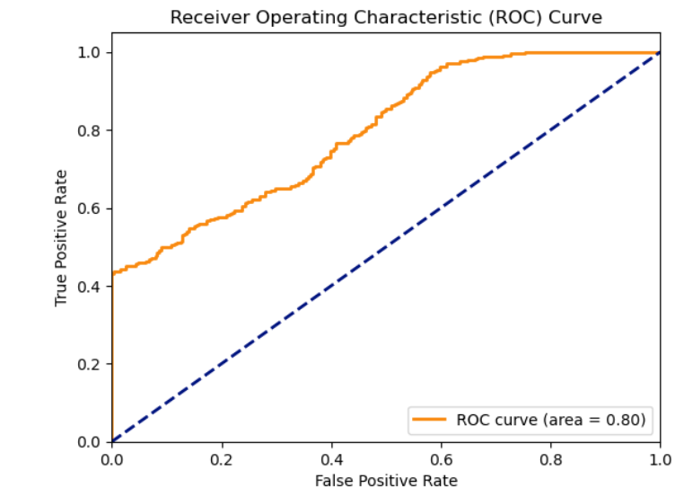
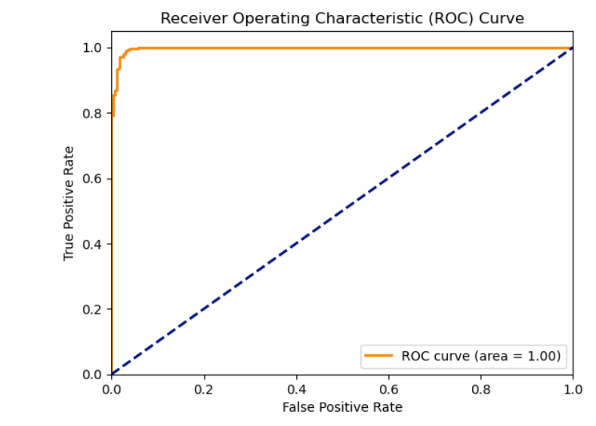
ROC Curves
Notes:
I wanted a better visualization of how well this model actually does, so I took both the original model and the expanded model and generated ROC curves for them. The one on the left is the original model with just the quantitative variables and the one on the right is inclusive of all of the features. We can see that the model obviously does much better with a wider range of parameters, as the area is near 1 and the graph is situated in the top left corner, which means the classifier is strong, especially wondering it’s away from the line of no-discrimination.

Slide 16
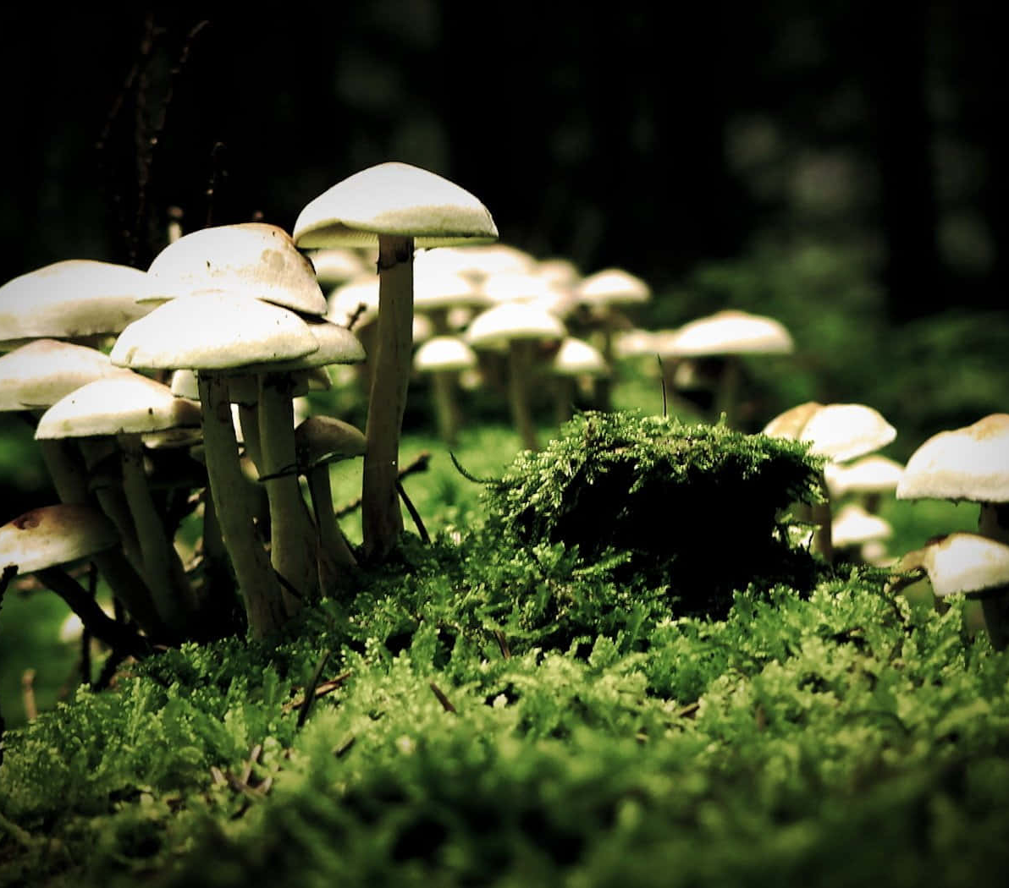
SVM Modeling using RBF
Notes:
Despite achieving a pretty good model using Logistic Regression, I wanted to see how SVM would compare. SVM’s look for the optimal hyperplane that separates the data into classes with the maximum margin in between, where the support vectors are the data points that re the closest to the decision boundary (aka the hyperplane), and the margin is the distance between the support vectors and the hyperplane. I figured that because SVM’s can handle both linearly and non-linearly separable datasets, they could be useful for our mushroom classification.
I figured that SVM would be much better with classification of the mushrooms due to the complex decision boundaries, but at the same time I knew that SVM’s could also struggle with large datasets. So I just wanted to see what would happen.
The standard kernel was used for this section.

Slide 17
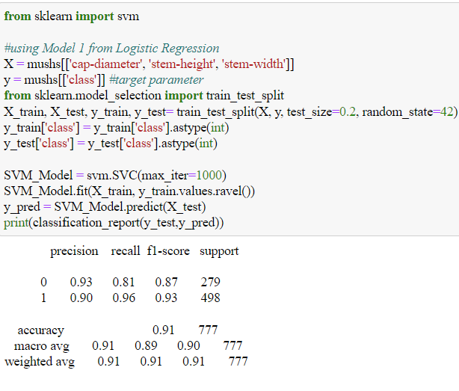
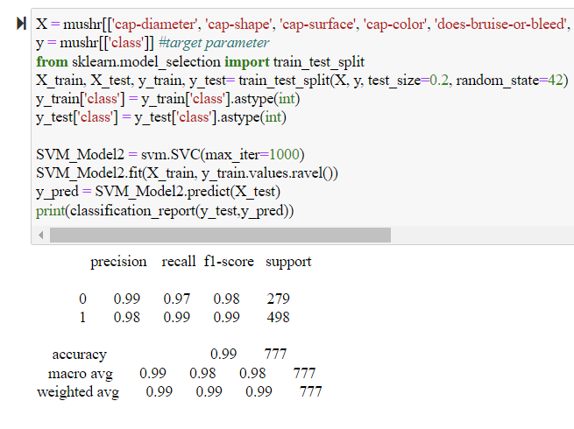


SVM Modeling
Notes:
I ended up using both the datasets from the basic and the expanded models from Logistic Regression here again with SVM to see how SVM would deal with both datasets. We can see that both models are much better. For Model 1, LogReg had a 70% accuracy, but that was increased to 91% with SVM. In addition to this, using all of the features made the model near perfect, with an accuracy of 99%.
I presumed this was due to the model complexity, where SVM can capture greater complex relationships compared to Logistic Regression. The default kernel is also incredibly versatile and can understand complex non-linear relationships in the data.

Slide 18

SVM Modeling with Different Kernels
Notes:
Finally, I just wanted to experiment with different kernels to understand my dataset and the complex relationships within it a little better.
Using the kernel trick, the data can be mapped into higher dimensions where the classes are more easily separable; different kernel functions can be used to transform the mushroom features more effectively.

Slide 19
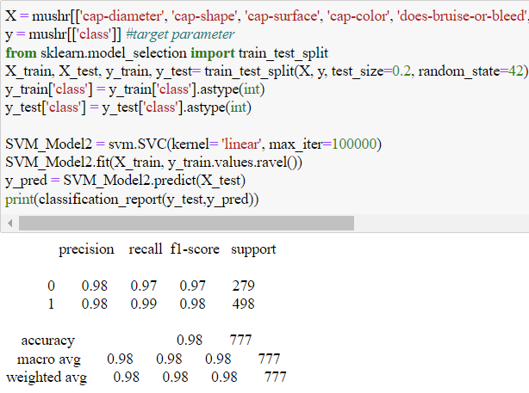

Linear
Did okay, but the RBF was still better
Conclusion: the dataset is not the most linearly separable, as the accuracy is slightly lower than the RBF kernel (99%).
Notes:
First, I started with the linear kernel. The accuracy here is slightly lower than that of the RBF kernel, which may indicate that the data is not linearly separable (although the difference isn’t really that great). I would still use the RBF kernel.

Slide 20
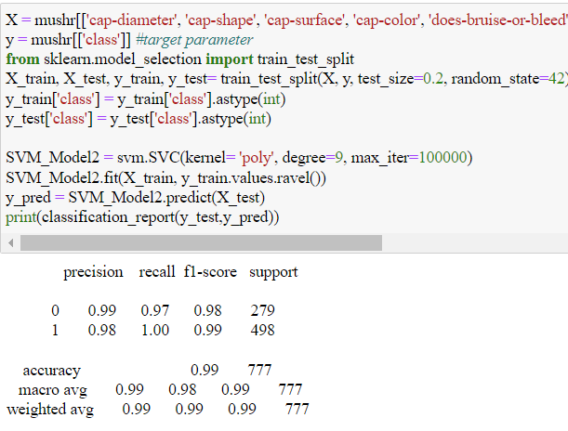

Polynomial
Best used when the decision boundary is nonlinear, but can still be approximated by a polynomial function
At higher hyperparameters, the model becomes ridiculously inaccurate.
Sweet Spot= 9 deg
Notes:
The next kernel used is the polynomial kernel. The polynomial kernel is best used when the decision boundary is nonlinear, but can still be approximated by a polynomial function. The Hyperparameters control the flexibility of this decision boundary. The kernel here did a great job, but that was only after playing around and using trial and error with the different degrees. I found that the sweet spot was 9 degrees, which netted me an accuracy of 99%. Although they provide flexibility in capturing non-linear relationships, at higher degrees, the model becomes ridiculously inaccurate.

Slide 21
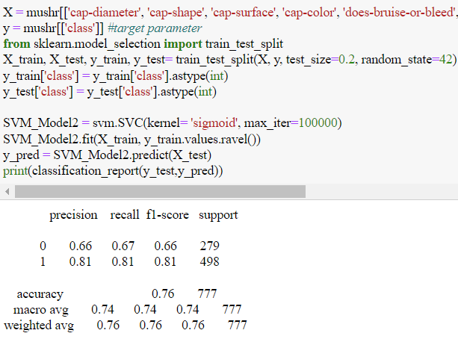

Sigmoid
Not great
Dataset is not sigmoidally distributed
Notes:
The next kernel used is the sigmoid kernel. For the Sigmoid kernel, which assumes that the data distribution is sigmodal, the accuracy was 76% which is subpar at best. The function isn’t flexible enough to model complex decision boundaries effectively.

Slide 22
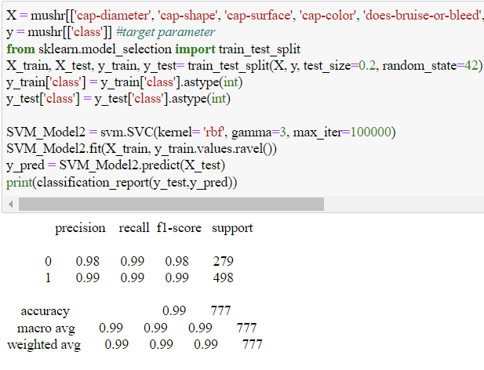

RBF & Gamma
Best out of all of them
Gamma value greater than 4 drops off accuracy significantly (shifts towards overfitting)
Notes:
Finally, I used the RBF kernel again but played around with the gamma value. The RBF kernel seems to be the best to take into account all of the complex relationships, but a gamma value greater than 4 makes the model more prone to overfitting and memorizing the data rather than generalizing. As gamma increases, the variance of the model also increases, which means that the model becomes more sensitive to noise.
I found that SVM with the default RBF kernel was the best model out of them all with an accuracy of 99%.

Slide 23
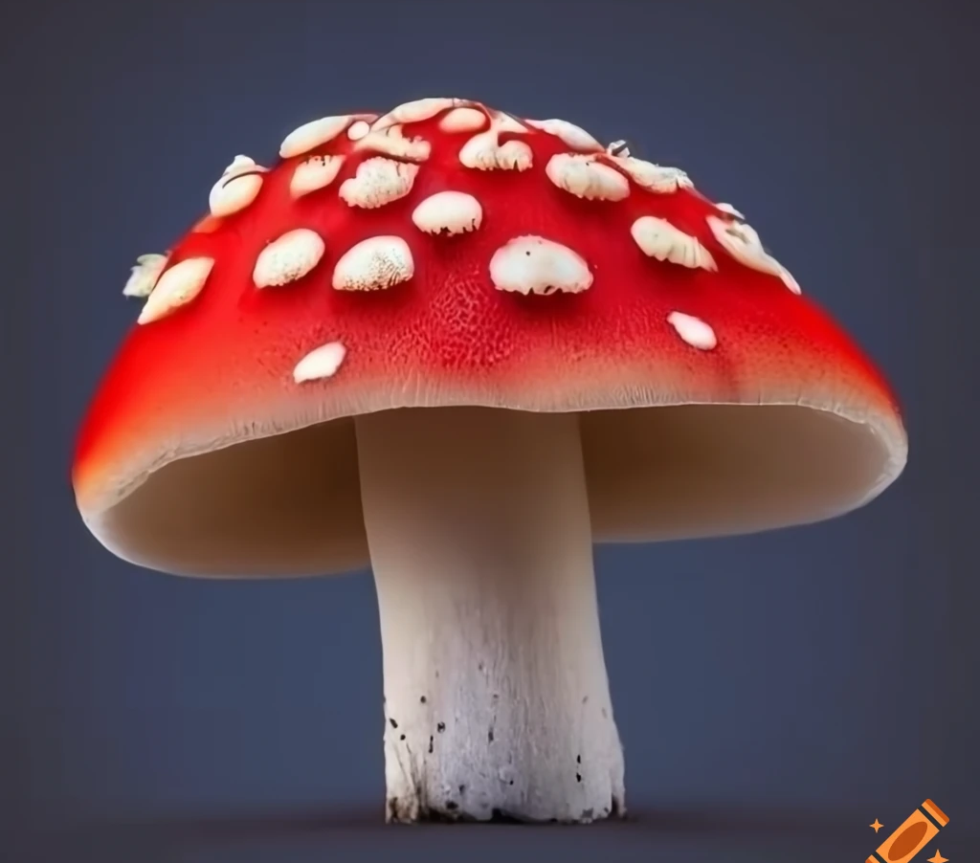
Lessons Learned
Notes:
Now for my lessons learned.

Slide 24
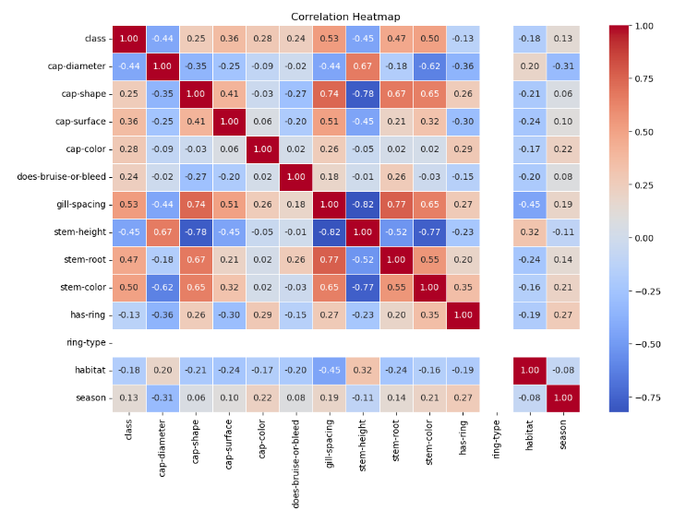
Correlation Heatmap
Looking at the variables and their relationships to identify which ones are best to subset to
Creating better models by eliminating redundant information and reducing dimensionality to improve model performance
Eliminating highly correlated features that can affect the model
Should have started with this.
Notes:
At the end of my study, I wanted to create better visualizations for the analysis and ended up creating this correlation heatmap that tells us the relationships between different variables. I realized that I could have used this at the beginning in order to create better models by subsetting the data to eliminate redundant information or highly correlated features that could affect the model. This could have improved model performance and reduced the dimensionality of the data. Next time, I would start with this.

Slide 25

Conclusion
Purpose: Understanding Classification Models & Their application to mushroom classifications
Narrowed down the data set, encoded variables, imputated values
Created 2 Logistic Regression Models (more features = greater accuracy)
SVM with RBF seemed to create the best classification model due to its ability to deal with high dimensional and highly non-linear datasets.
Notes:
Finally, the purpose of this analysis was to understand classification models and their applications to mushroom classification to create a generalized model that can predict whether a mushroom is edible or poisonous. I began the analysis by narrowing down the dataset, removing NaN values, encoding the categorical variables to numerical values and imputating values where ever they were missing in order to preserve the rest of the dataset. I did two logistic regression models, one with solely numerical features, and one with all of the features in the dataset, both numberical and categorical features. Including more features made the model much much better. And finally, I played around with SVM and different kernels to create the best model, which was SVM with the RBF kernel. This model was able to predict which mushrooms where edible vs poisonous with 99% accuracy, showing SVM’s ability to deal with high dimensional and highly non linear datasets.

Slide 26
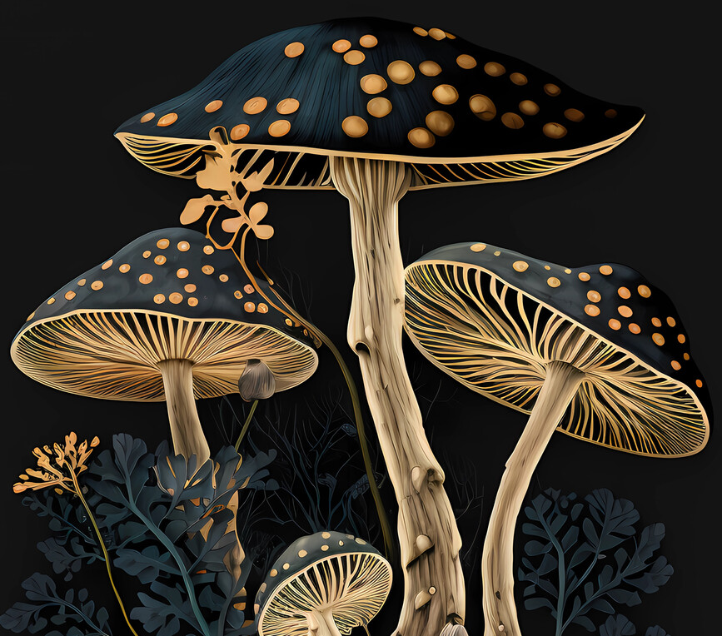
Thank you!
Notes:
And that’s all I had today. Thank you for your time!

